Slide 1

EXPLORATORY DATA ANALYSIS ON
AMCAT
Mohammed Asnan

Slide 2


About me
Background ?
My name is Mohammed Asnan, Currently pursuing Bachelors of Computer Applications
Why you want to learn Data Science
Data Science interests me because of its power to transform industries and streamline decision-making processes. AI, in particular, has made it possible to complete activities that previously required substantial time and effort, resulting in faster, data-driven solutions and the development of predictive models. As a Data Scientist intern at Innomatics Research Lab, I am continually exposed to actual case studies, allowing me to expand my expertise and study developing trends in the area.
LinkedIn and GitHub profile URLs -
www.linkedin.com/in/mohammed-asnan
https://github.com/Mohammedasnan

Slide 3
Agenda (This should be the PPT flow)
Business Problem and Use case domain understanding.
The engineering sector is grappling with the challenge of helping graduates navigate their career paths effectively. While many graduates possess a blend of cognitive, technical, and personality skills, they often face difficulty in securing positions in an increasingly competitive job market.
To address this issue, we are embarking on an in-depth data exploration and analysis project. By examining a rich dataset that includes employment outcomes, assessment scores across cognitive, technical, and personality domains, as well as demographic factors, we aim to uncover key drivers of career success.
Our objective is clear to generate actionable insights that can reshape the employment journey for engineering graduates, helping them achieve fulfilling careers and long-term professional growth.
Objective of the Project
This project focuses on exploring the factors influencing employment outcomes for engineering graduates, particularly in terms of salary and specialization choices. By analyzing relationships between independent variables and the target variable (salary), we aim to identify trends and patterns that provide deeper insights into career trajectories.
Additionally, we will test a claim from a Times of India article, which suggests that fresh Computer Science graduates in certain roles can earn up to 2.5-3 lakhs. Another key focus is examining whether specialization preferences are influenced by gender. Ultimately, this project seeks to offer data-driven insights that can shape career decisions for engineering graduates.

Slide 4
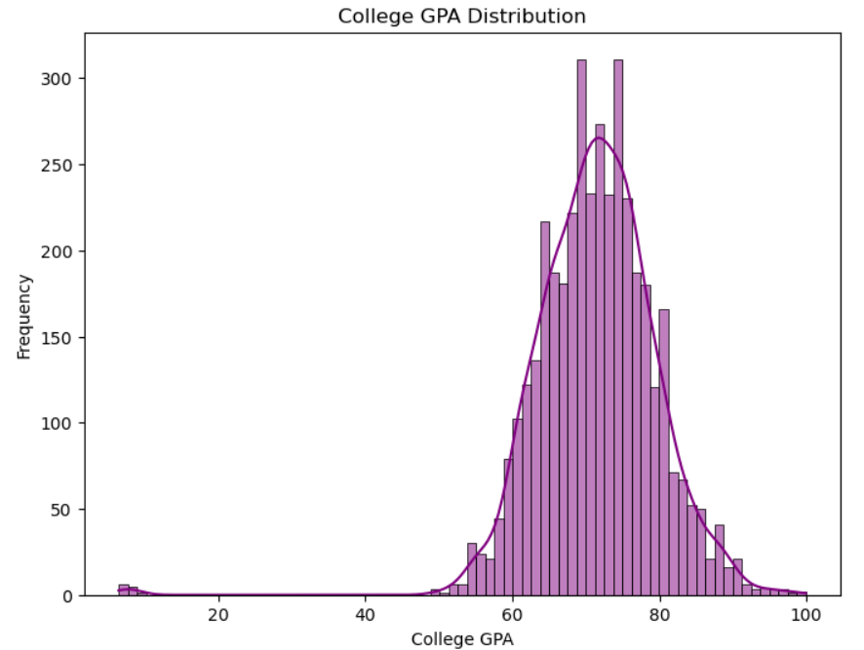
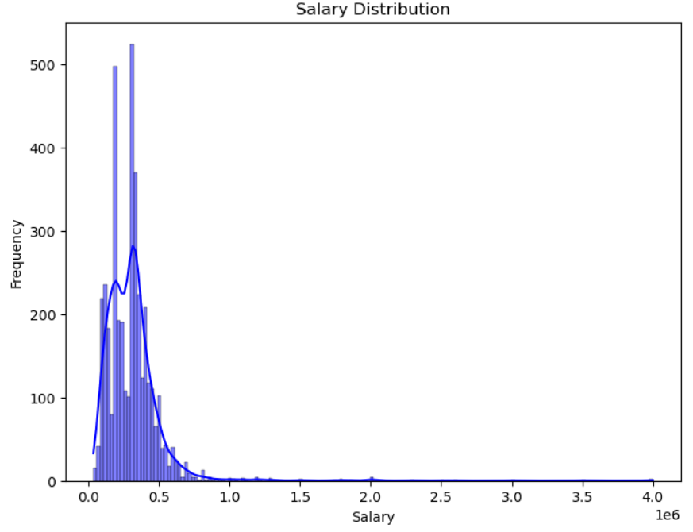
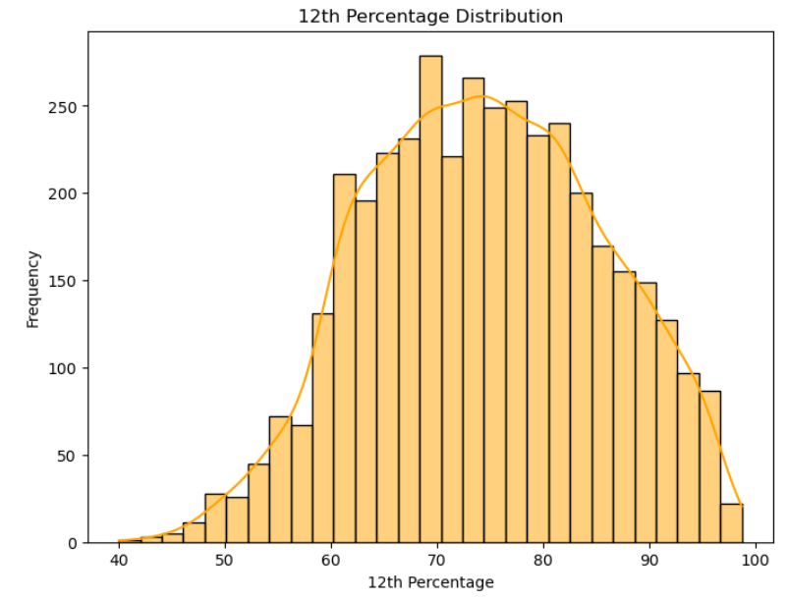
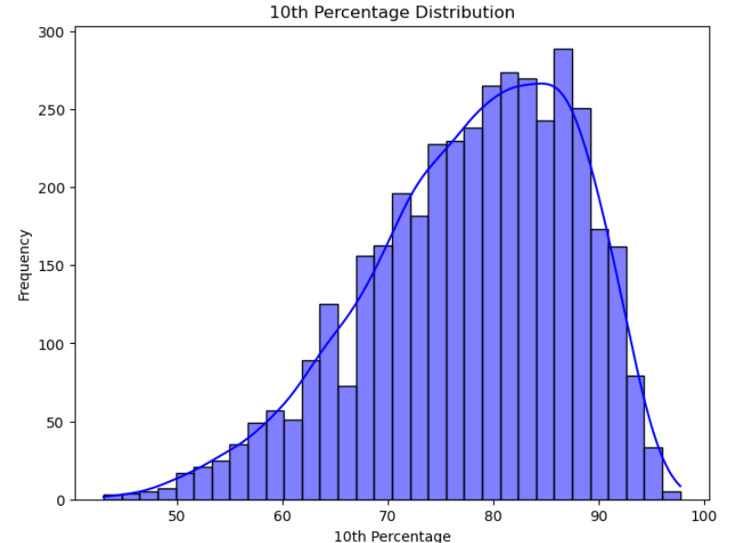
Univariate Analysis Steps
Numerical Variables
The College GPA is predominantly concentrated between 6.0 and 8.0, suggesting that the majority of students maintain a decent academic performance during their college years. This range indicates that most students perform consistently well, though not exceptionally high or low, reflecting a solid academic foundation for the majority.
The salary distribution is right-skewed, with most engineers earning below the mean. A few graduates earn significantly higher salaries, pulling the average upward.
The distribution of 12th-grade percentages mirrors the trend observed in the 10th-grade scores, with the majority of students achieving percentages between 60% and 80%. This suggests consistent academic performance across both grades for most students, with fewer students scoring significantly higher or lower.
The majority of students scored between 60% and 80% in their 10th-grade exams, indicating that most students performed moderately well. A smaller proportion of students achieved percentages either above 80% or below 60%, suggesting that exceptional or lower performance was less common within this group.

Slide 5
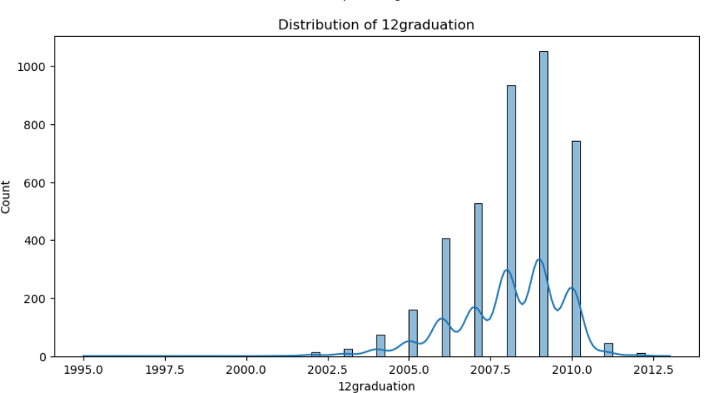
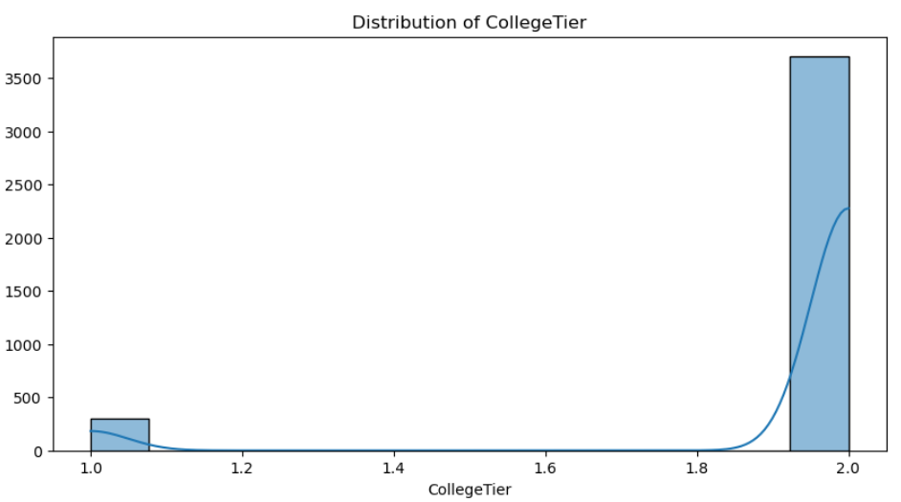
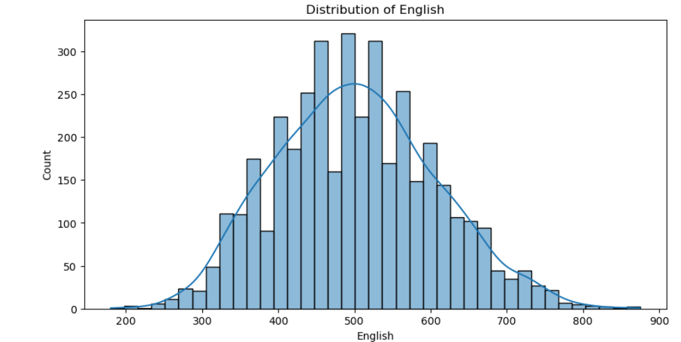
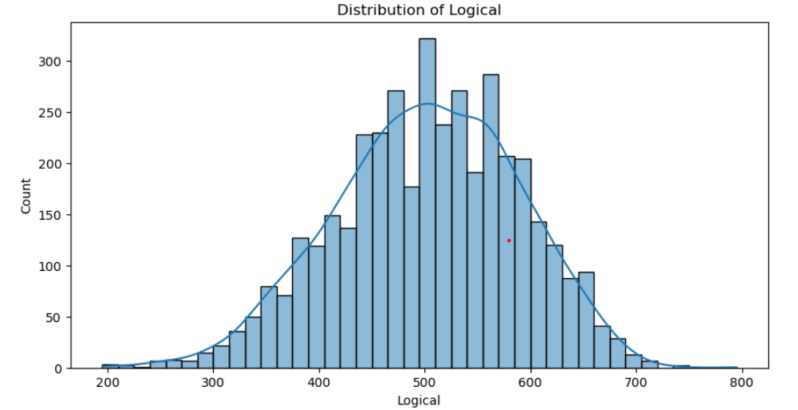
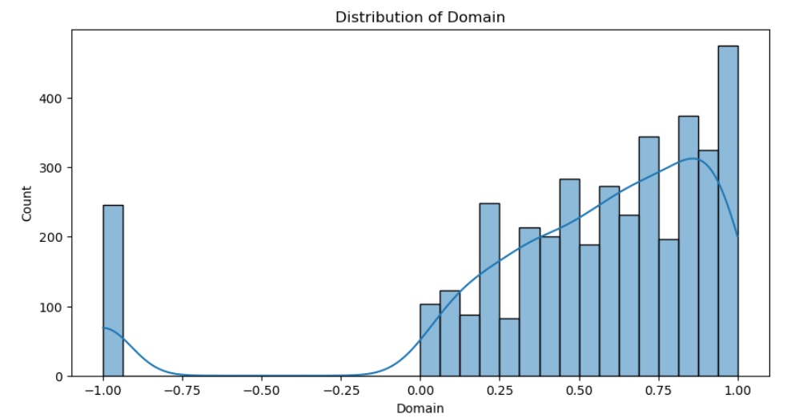
Histograms

Slide 6
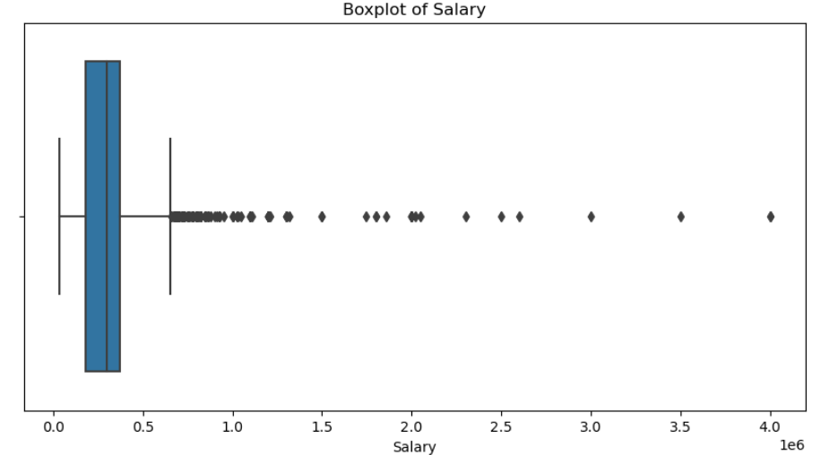
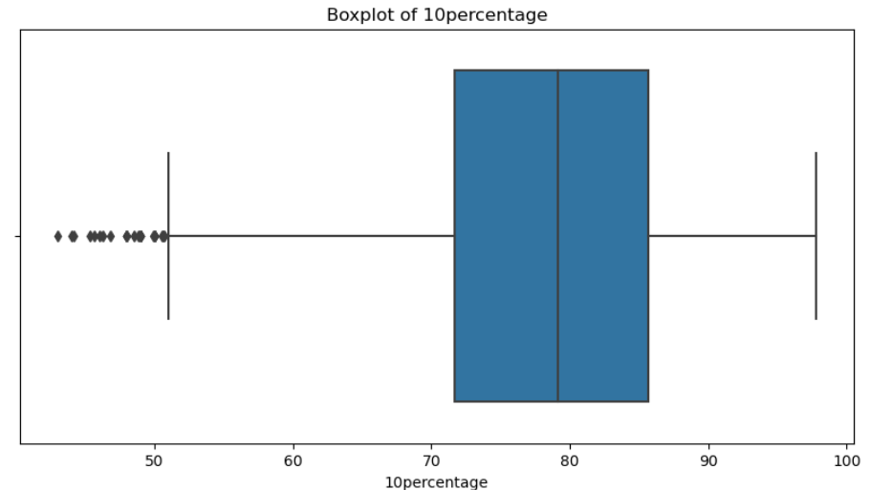
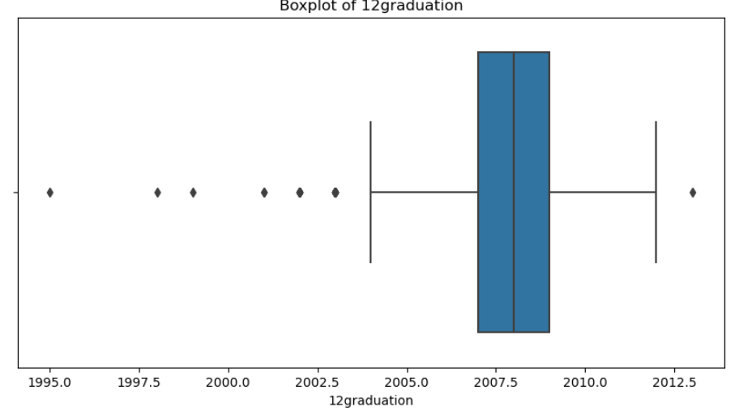
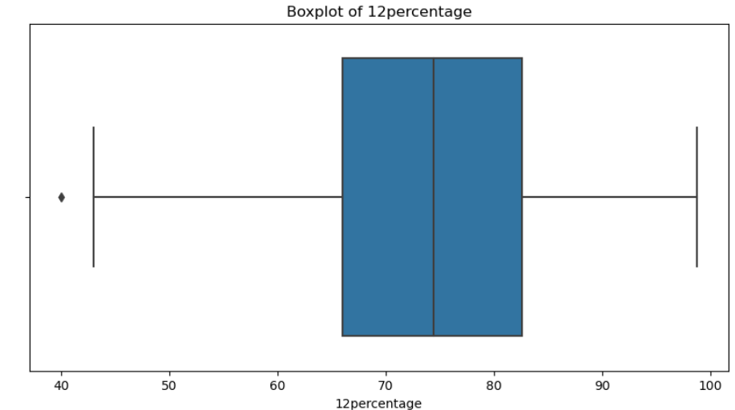
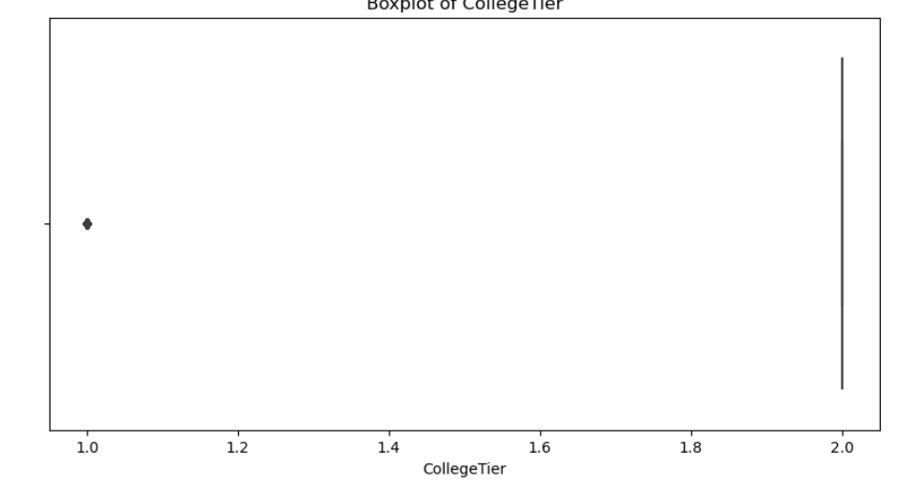
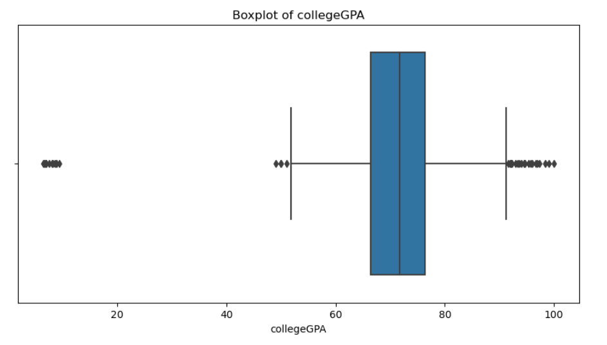
Boxplot

Slide 7
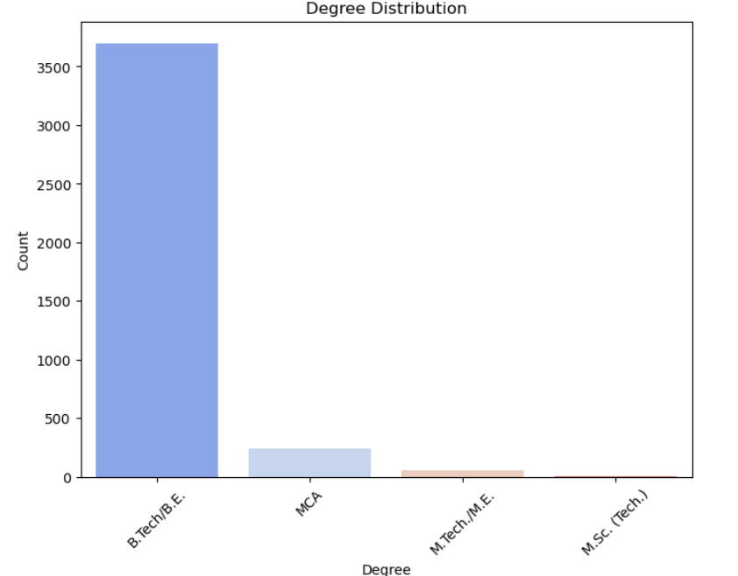
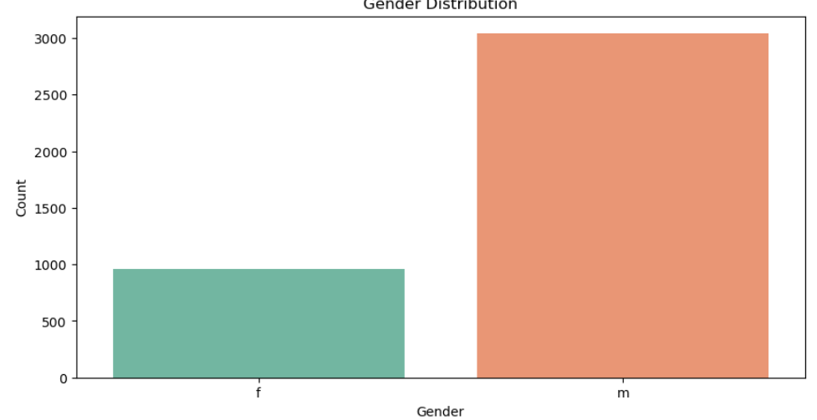
Univariate Analysis: Categorical Variables
The most common degree among the students in the dataset is B.Tech (Bachelor of Technology). This suggests that a significant portion of the student population is pursuing or has completed technical education, which may reflect the popularity and demand for engineering and technology-related fields.
The dataset shows a higher number of male students compared to female students, indicating a gender imbalance in engineering disciplines. This suggests that engineering fields may have a disproportionate representation of males, highlighting potential gender disparities in these areas of study.

Slide 8
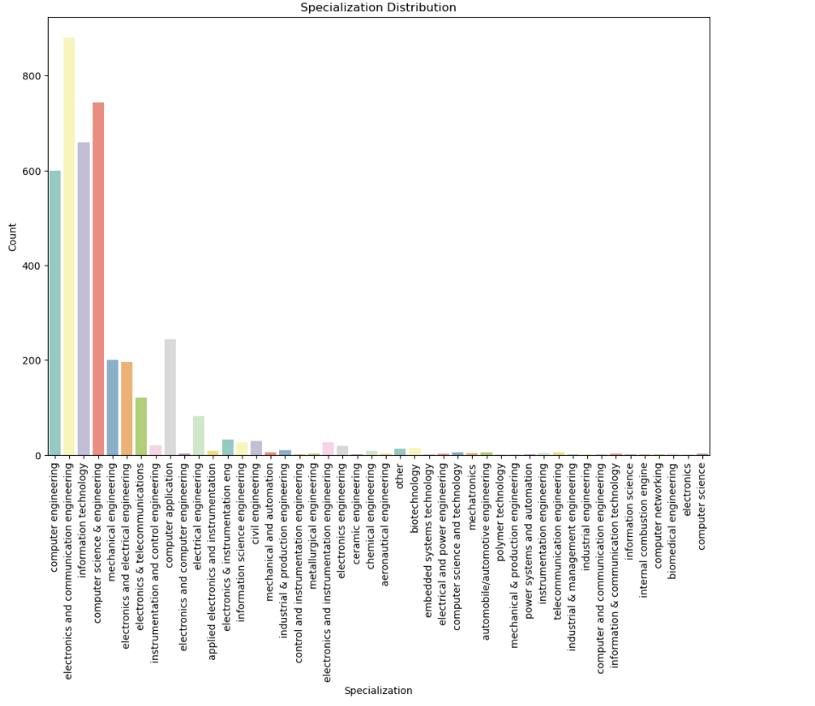
Computer Science Engineering (CSE) is the most popular specialization, followed by Mechanical Engineering and Electronics and Communication Engineering. This trend highlights the strong interest in technology-focused disciplines among students.

Slide 9
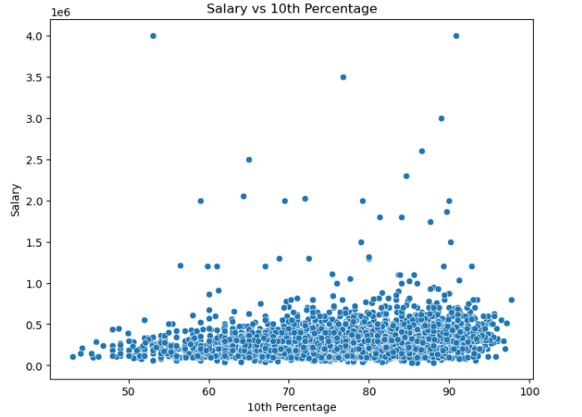
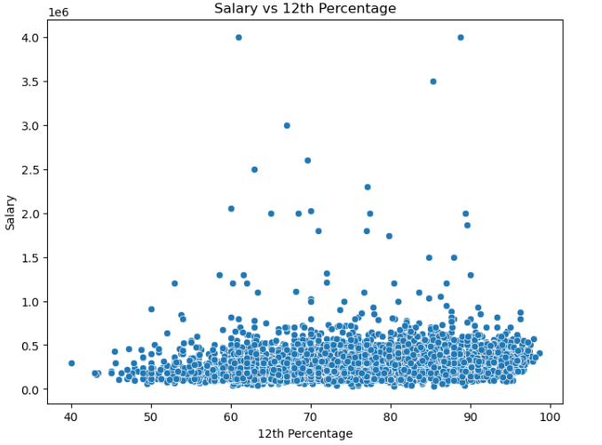
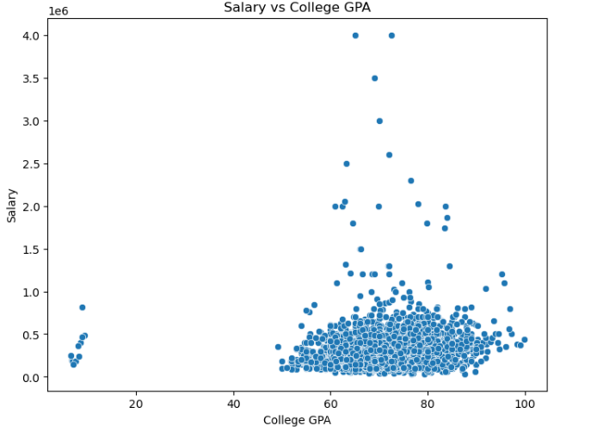
Numerical vs Numerical
There is no clear linear relationship between 10th-grade percentages and salary, as some students with lower percentages are earning higher salaries. This indicates that early academic performance may not strongly correlate with job outcomes in the long term.
Similar to the 10th-grade results, there is no strong correlation between 12th-grade percentage and salary. This suggests that high school academic performance may not directly influence salary outcomes in the job market.
There is a slight positive trend between college GPA and salary, indicating that higher GPAs are associated with slightly higher salaries. However, this relationship is not very strong, suggesting that other factors may also significantly influence salary outcomes.

Slide 10
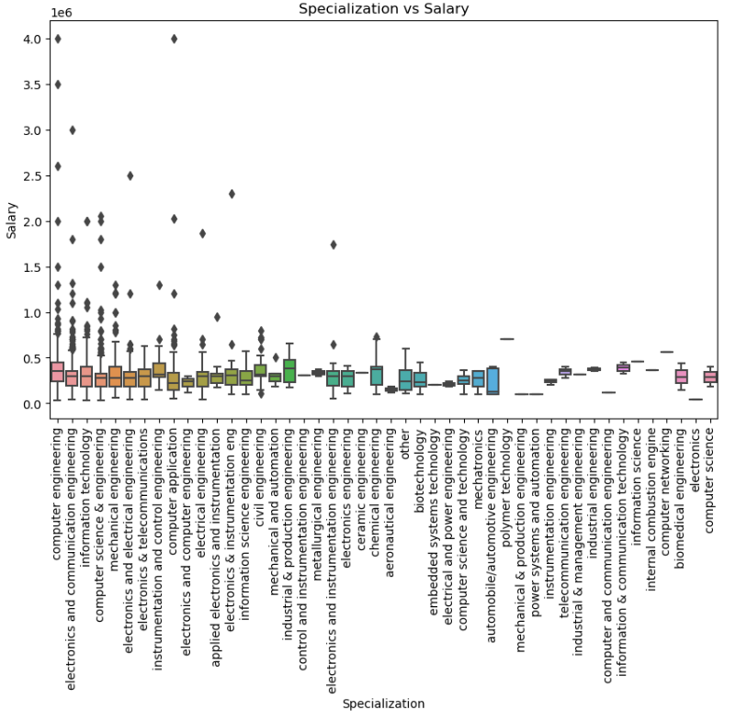
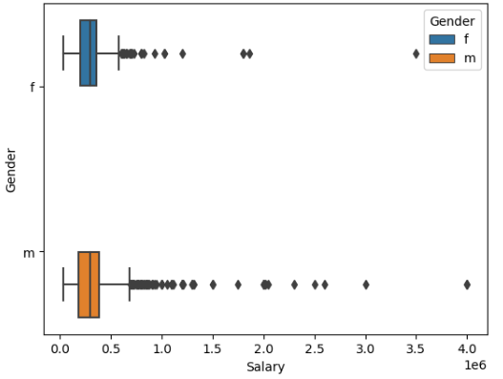
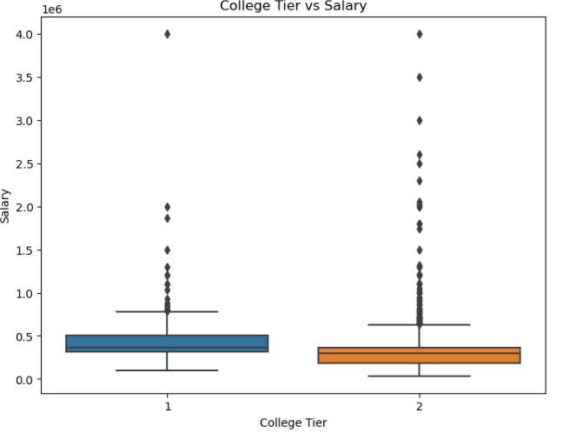
Categorical vs Numerical
There is a noticeable difference in salary distribution between genders, with males earning higher salaries on average than females. However, there are outliers in both categories, indicating that some females earn significantly higher salaries than their male counterparts, and vice versa.
Students specializing in Computer Science and Electronics generally earn higher salaries compared to those in Civil or Mechanical Engineering. Additionally, there are notable high-salary outliers within the Computer Science specialization, highlighting the lucrative opportunities in tech-related fields.
Students from Tier 1 colleges tend to earn higher salaries compared to those from Tier 2 and Tier 3 colleges. This suggests that the reputation or tier of the college may significantly influence salary outcomes for graduates.

Slide 11
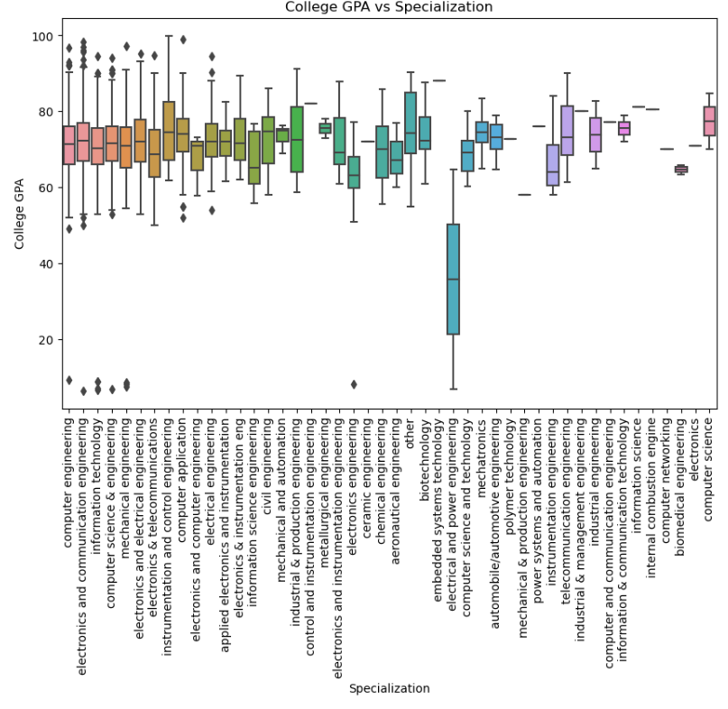
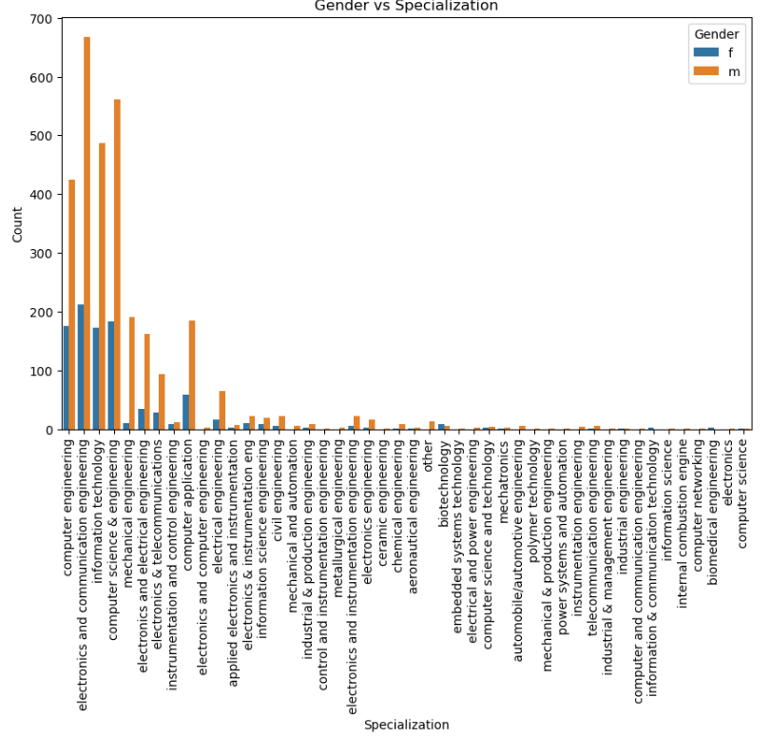
Categorical vs Categorical
College GPA tends to be higher for students specializing in Computer Science and Electronics compared to those in Mechanical, Electrical, and Civil Engineering. Additionally, there is less variation in GPA among students in Mechanical and Civil Engineering specializations.
In most specializations, males outnumber females. However, fields like Computer Science show a more balanced gender distribution, whereas Mechanical and Electrical Engineering are predominantly male-dominated.

Slide 12
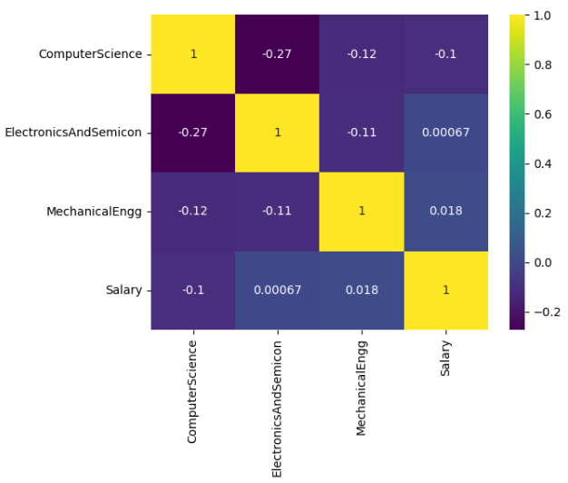
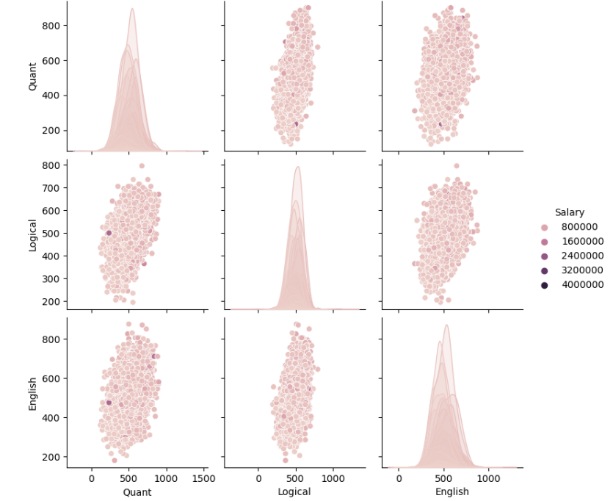
Multivariate Analysis
1.How does Quant, Logical, and English scores collectively impact the Salary?
2.Different Engineering specializations contribute to Salary

Slide 13
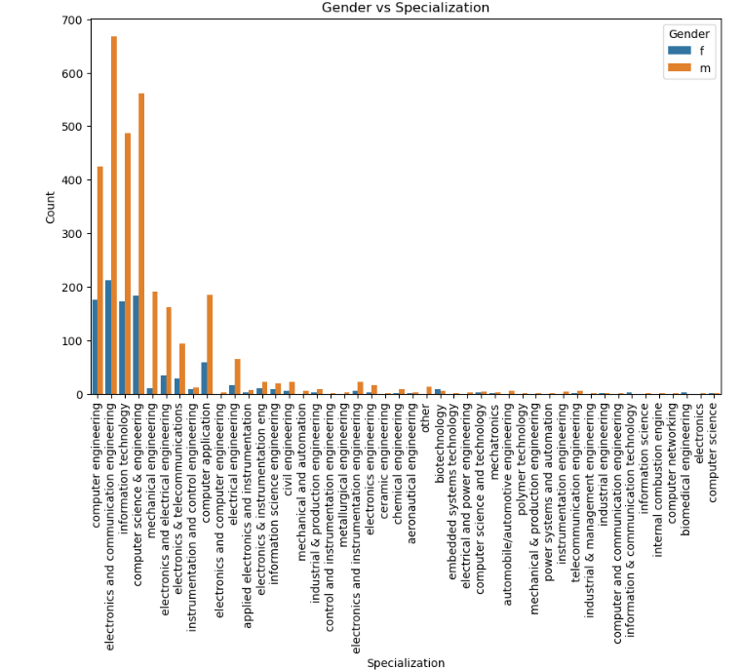
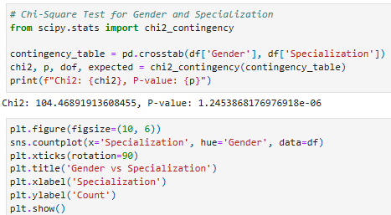
Is there a relationship between gender and specialization? (i.e. Does the preference of Specialization depend on the Gender?)
If the p-value is less than 0.05, we can reject the null hypothesis and conclude that there is a significant relationship between gender and specialization. Conversely, if the p-value is greater than 0.05, we fail to reject the null hypothesis, indicating that gender does not significantly impact the choice of specialization.

Slide 14
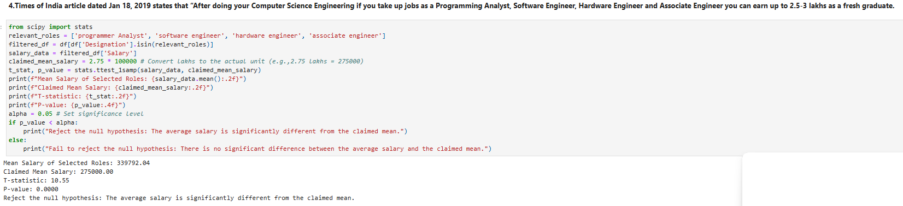
Research Question

Slide 15
Conclusion
The analysis reveals several key insights regarding employment outcomes for engineering graduates. Firstly, there is no significant relationship between gender and specialization, indicating that an individual’s choice of specialization does not depend on their gender, as evidenced by a p-value greater than 0.05. Additionally, the data suggests that the tier of the college attended does not significantly influence salary outcomes.
Furthermore, by comparing average salaries across different fields, such as Computer Science, Mechanical Engineering, and Civil Engineering, we can identify which specializations tend to command higher salaries and which ones may lag behind. Finally, the analysis highlights the importance of location in salary negotiations, with cities like Bangalore, Gurgaon, and New Delhi typically offering higher salaries compared to smaller cities, even for the same job title and experience level.

Slide 16

THANK YOU

